Slide 1
CANTEEN MANAGMENT
SYSTEM
TEAM MEMBERS:
SHREYA ARUN:CB.SC.U4AIE23253
SIRI SANJANA S:CB.SC.U4AIE23249
VARSHITHA THILAK KUMAR:CB.SC.U4AIE23258

Slide 2



INTRODUCTION
OVERVIEW
CONCLUSION

Slide 3
INTRODUCTION
This innovative software offers a comprehensive suite of features designed to simplify daily tasks and optimize resource utilization.
Managing a canteen can be time-consuming and prone to errors, particularly with large volumes of orders and limited resources.
Traditional methods, like manual record-keeping and order processing, can be inefficient and hinder smooth operation.

Slide 4
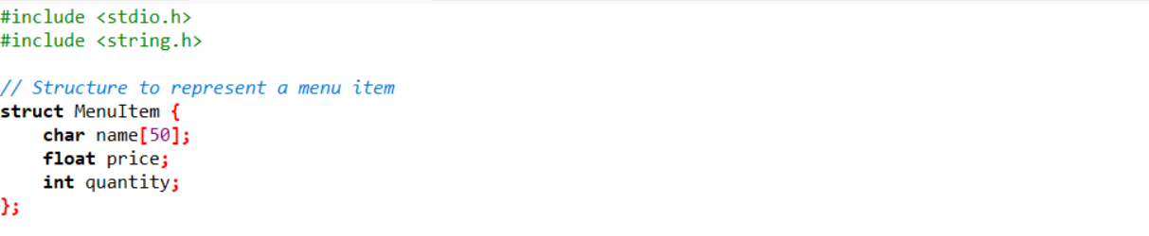
Structure to represent a menu item

Slide 5
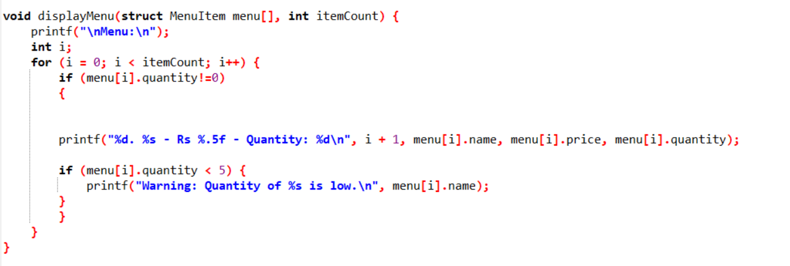
Function to display Menu

Slide 6
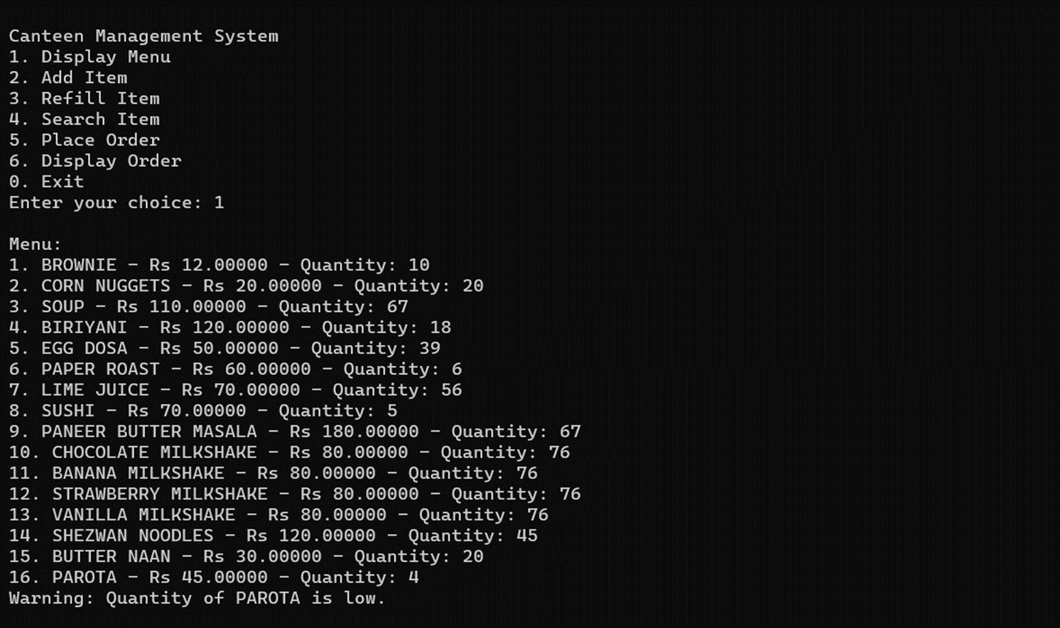
Output: Display menu

Slide 7
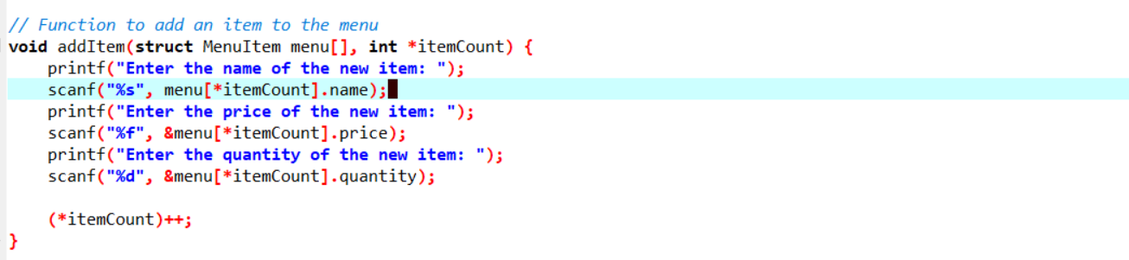
Function to add item to the menu

Slide 8
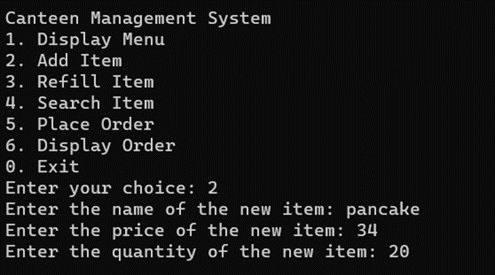
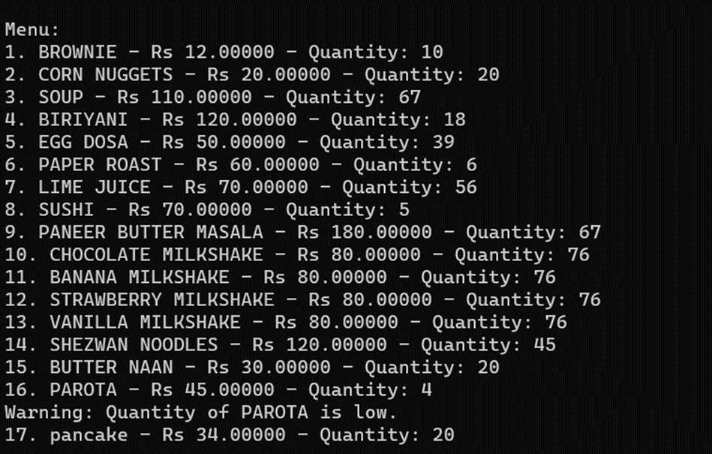
Output: Add item to menu

Slide 9
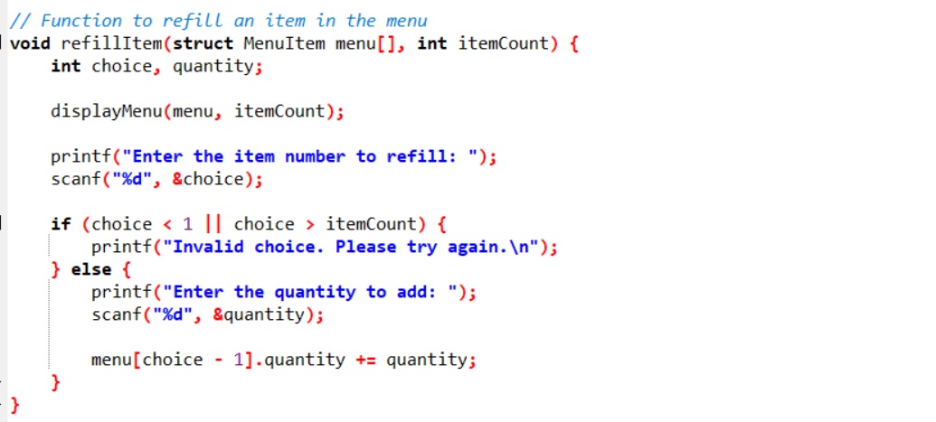
Function to refill an item in the menu

Slide 10
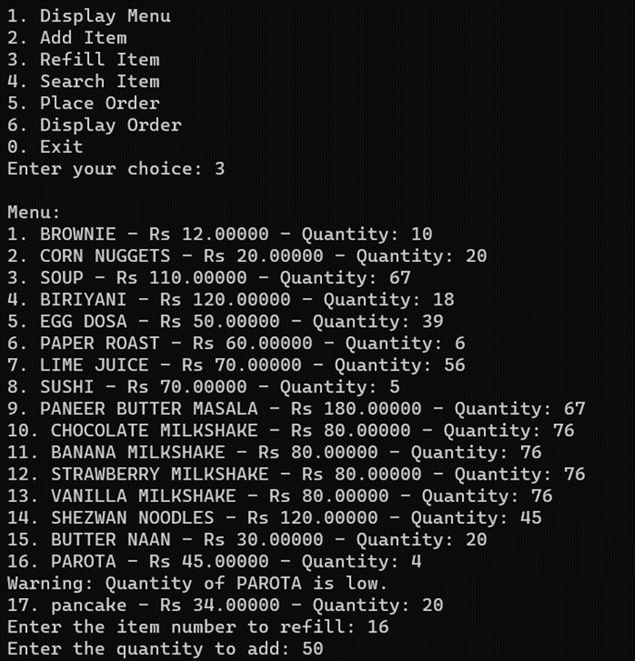
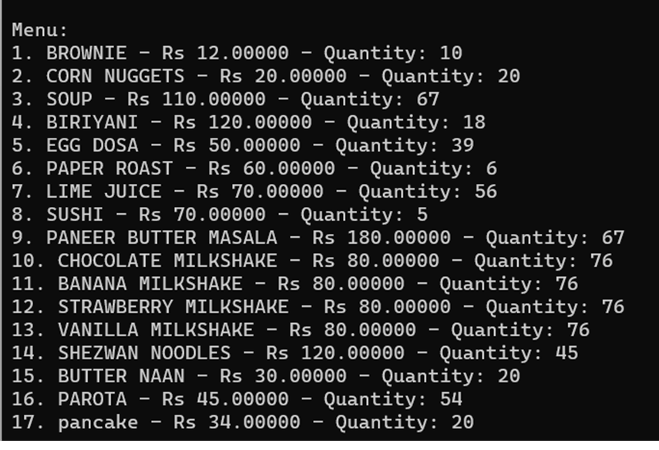
Output: Refill item to menu

Slide 11
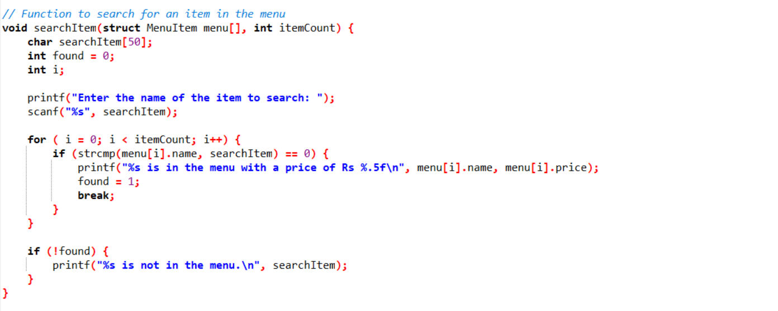
Function to search a food item

Slide 12
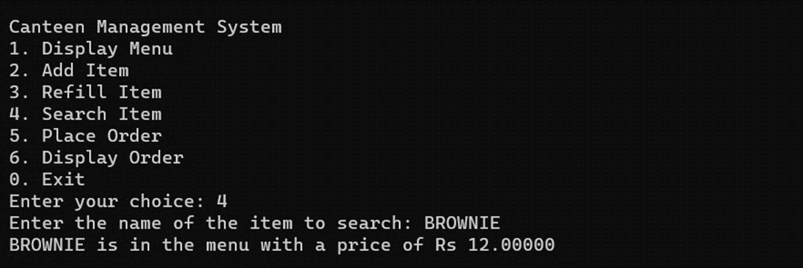
Output: Search item in menu

Slide 13
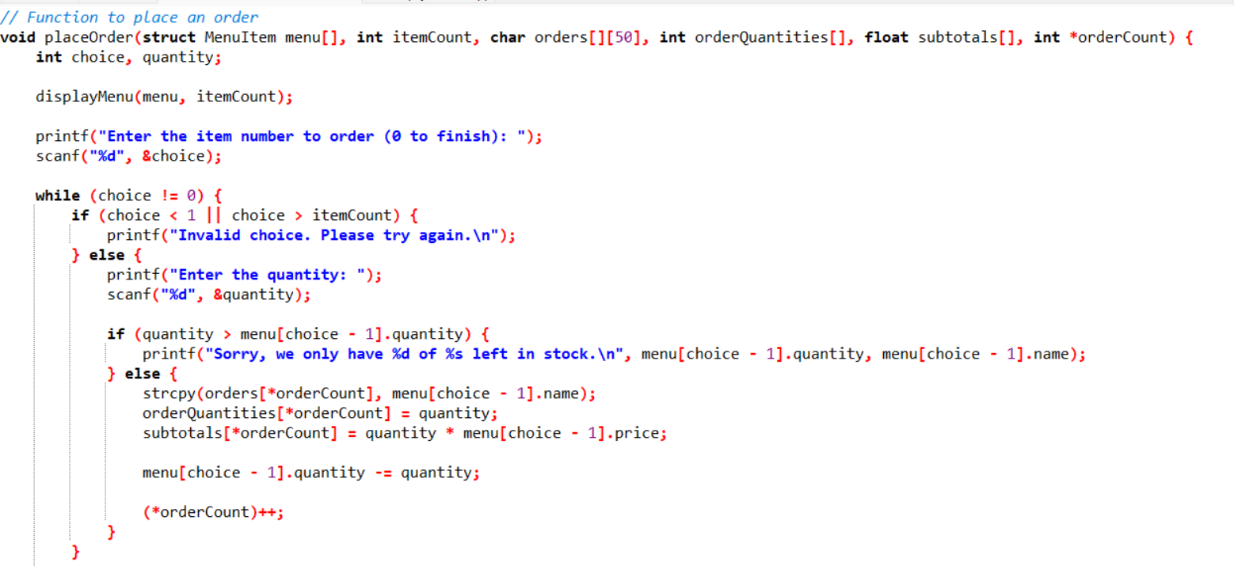
Function to place an order

Slide 14
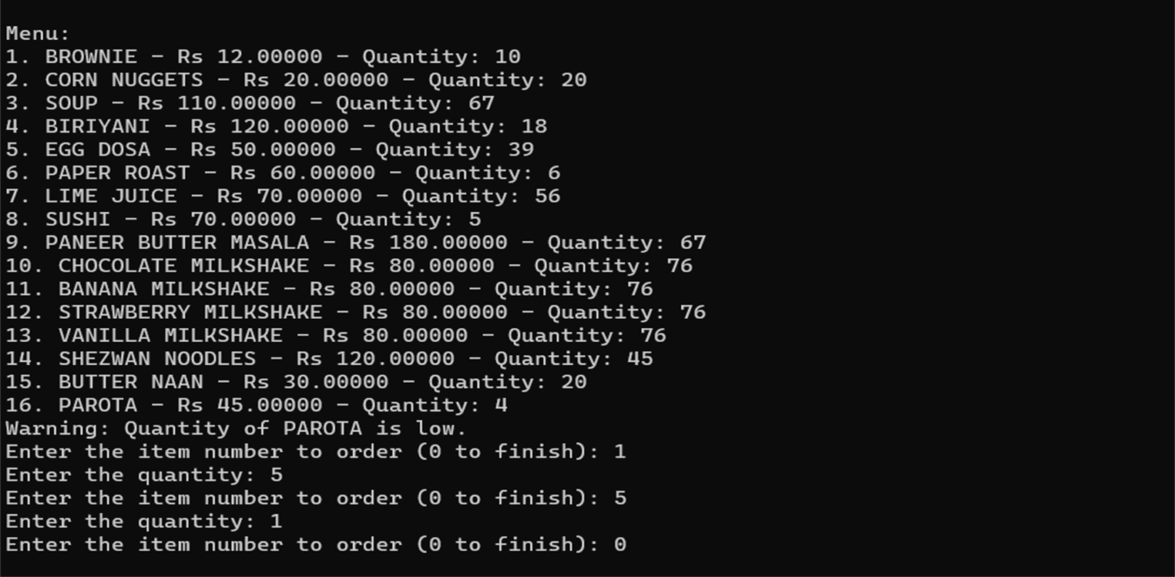
Output: Place order

Slide 15
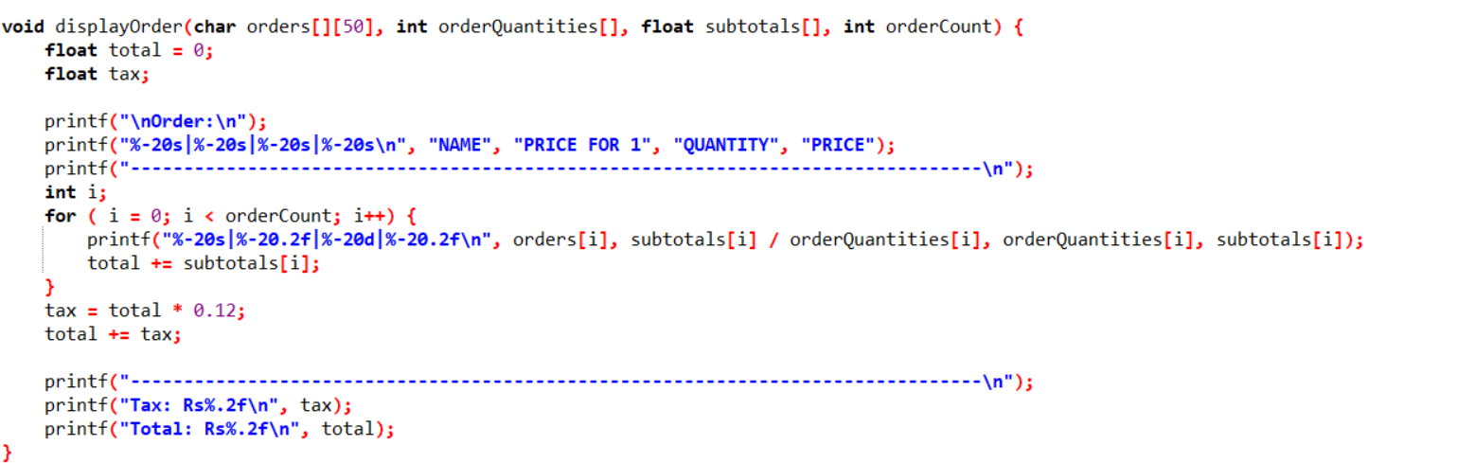
Function to display the order

Slide 16
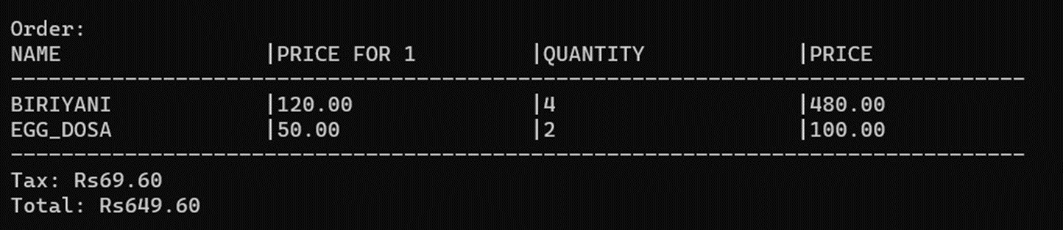
Output: Displaying placed order

Slide 17
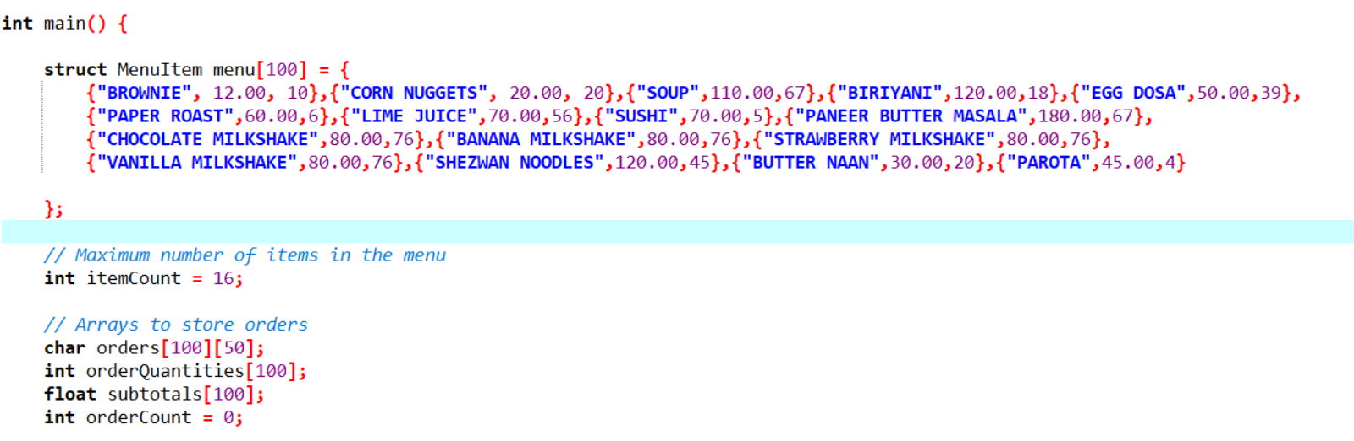
Main Function

Slide 18
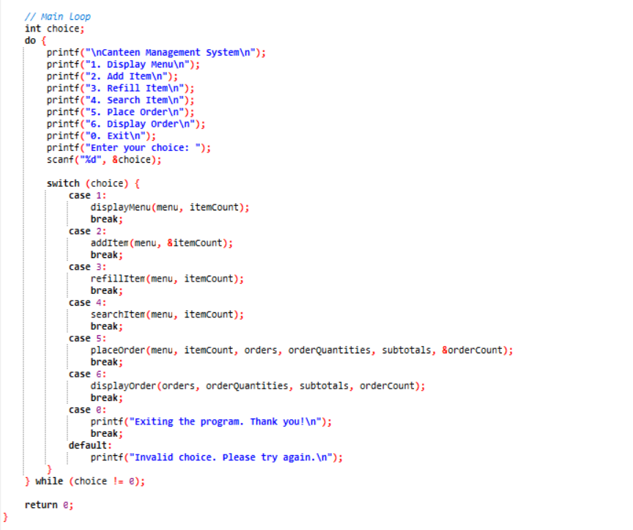
Main Function

Slide 19
FILE HANDLING-Reading and writing

Slide 20
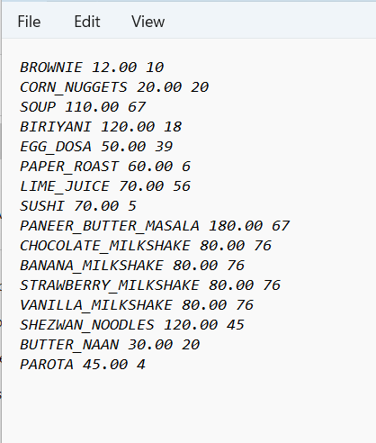
Menu in TXT file

Slide 21
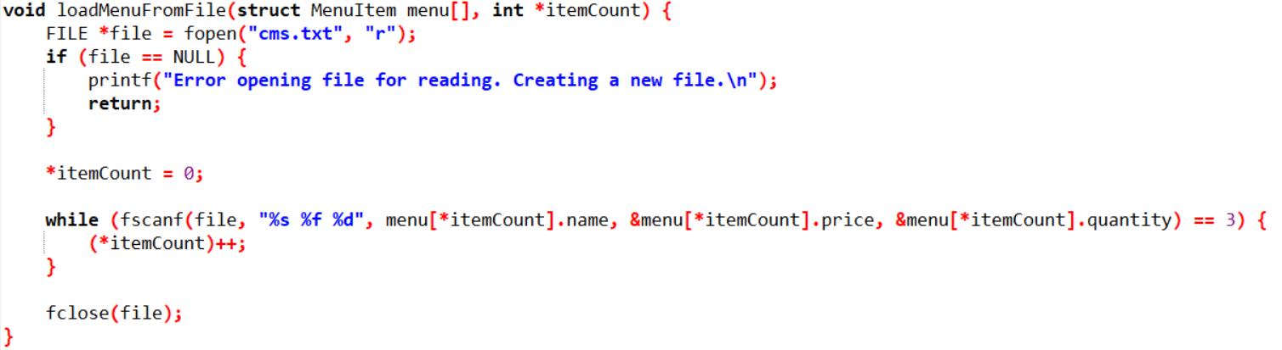
Function to load menu from txt file

Slide 22
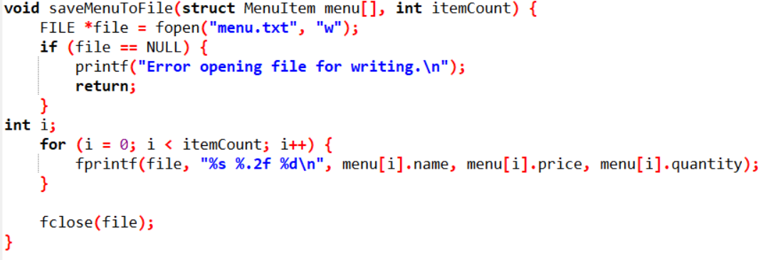
Function to save menu to txt file

Slide 23
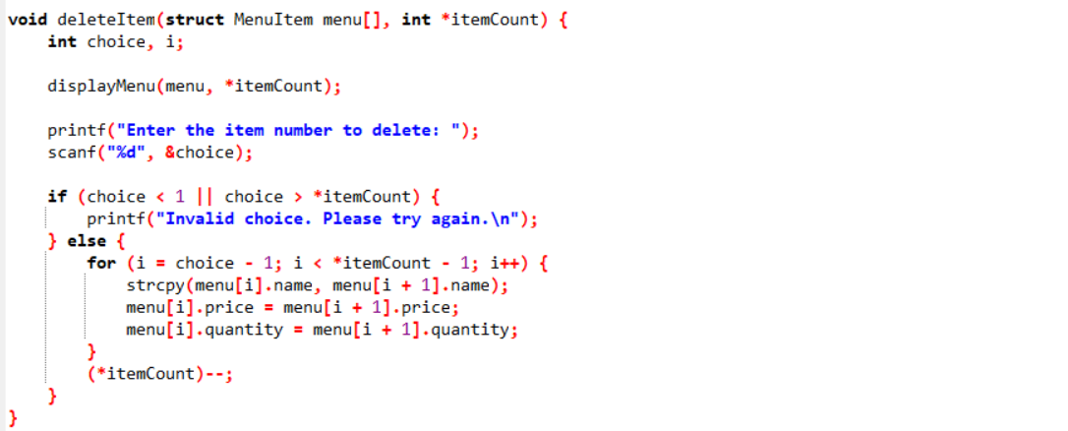
Function to delete item

Slide 24
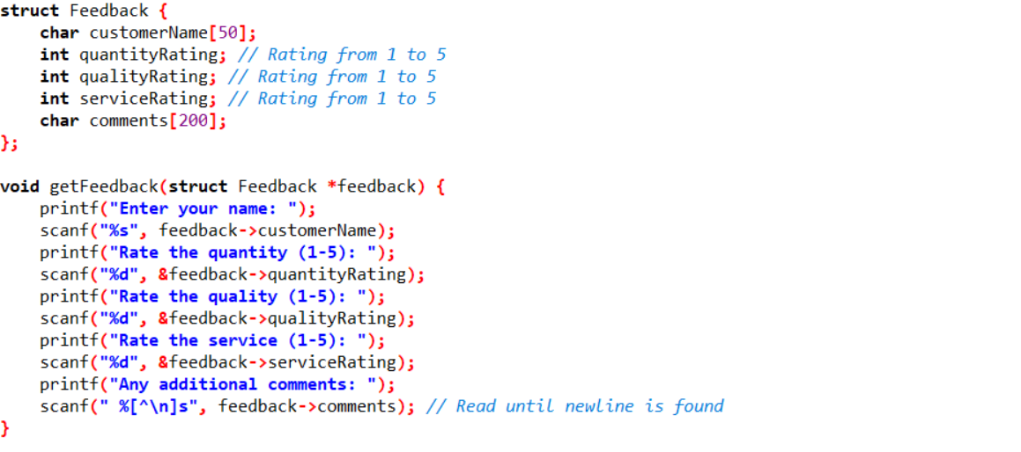
Function for feedback in txt file

Slide 25
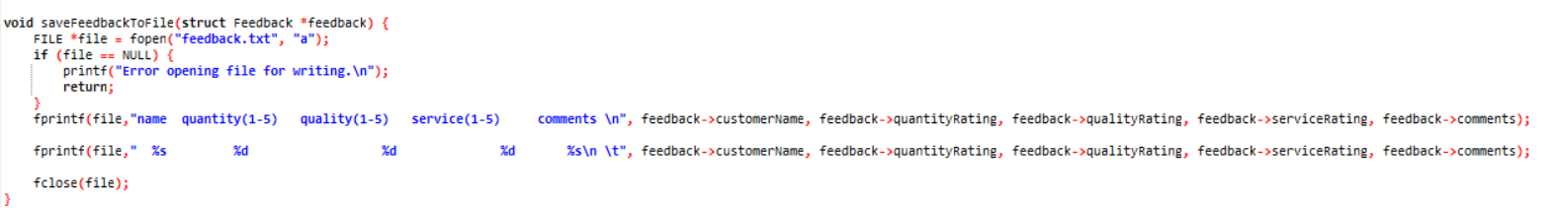
Function for feedback in txt file

Slide 26
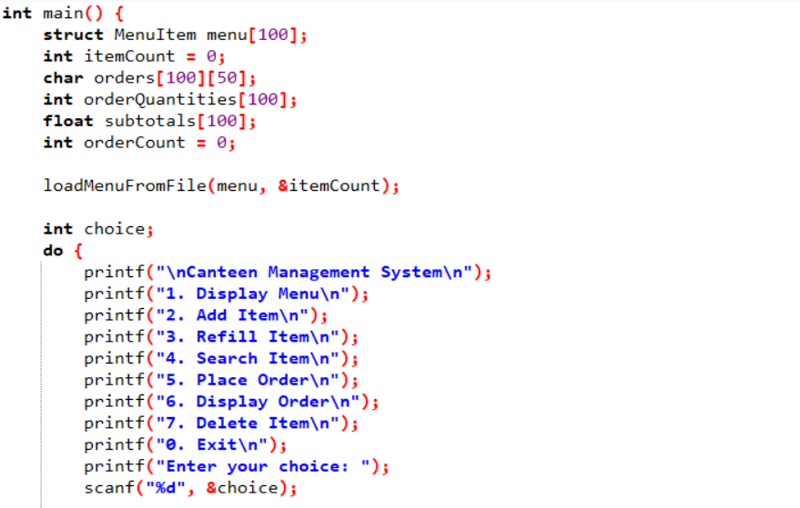
MAIN FUNCTION for Code with txt file

Slide 27
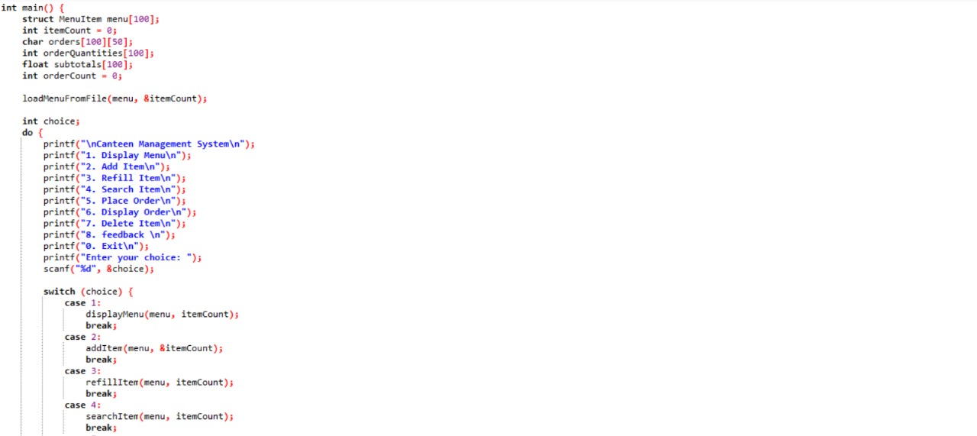

Slide 28
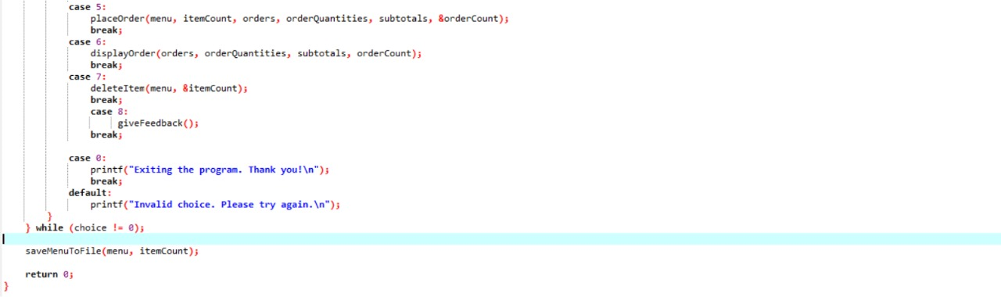

Slide 29
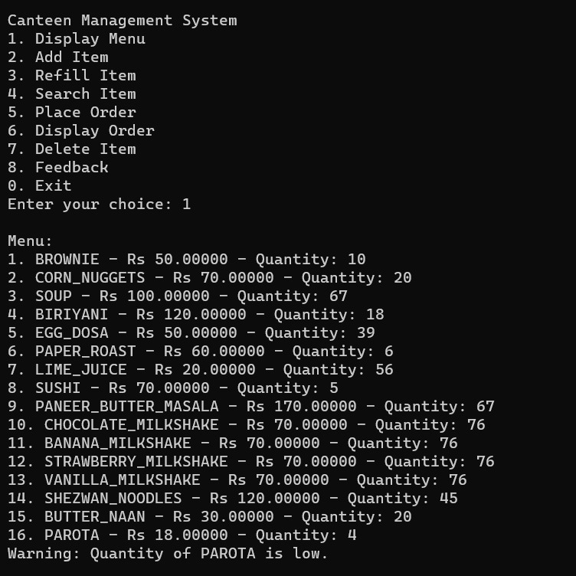
Output: Display menu

Slide 30
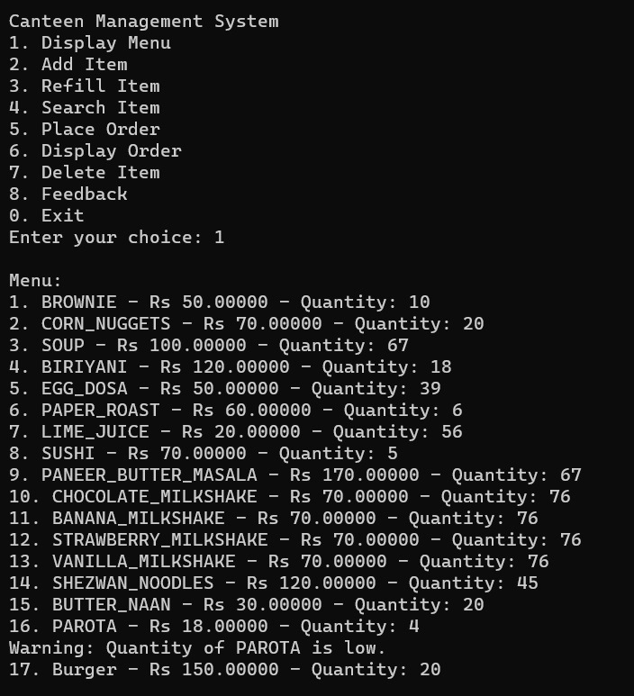
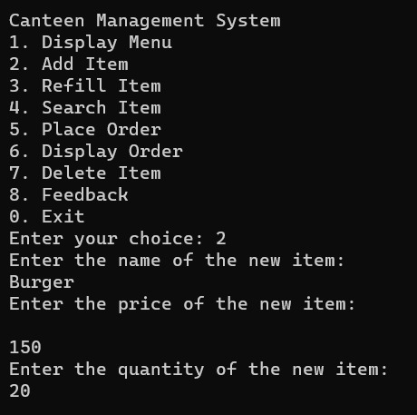
Output: Add item to menu

Slide 31
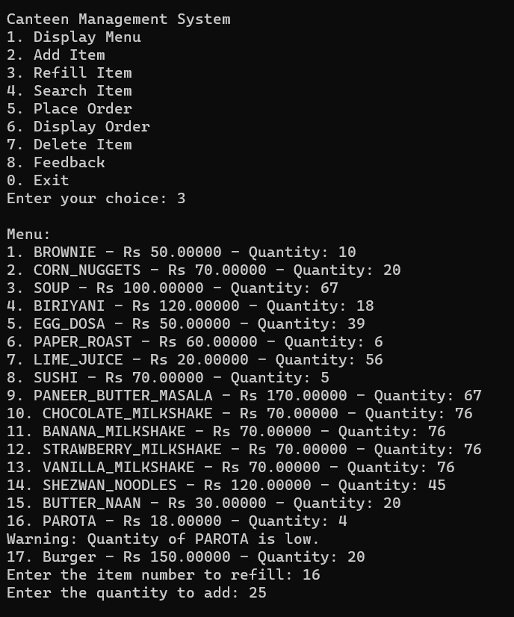
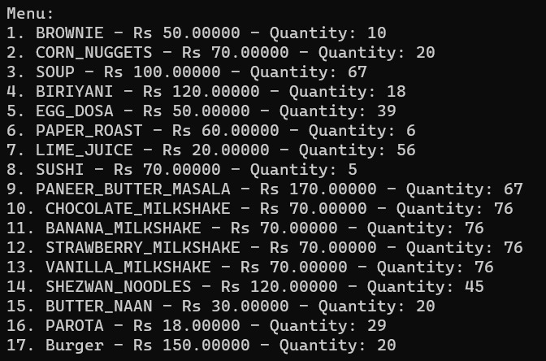
Output: Refill item to menu

Slide 32
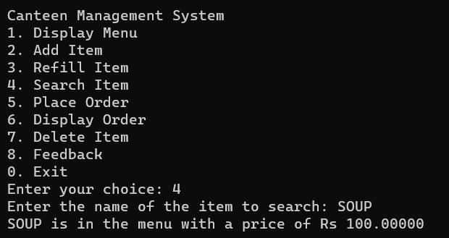
Output: Search item in menu

Slide 33
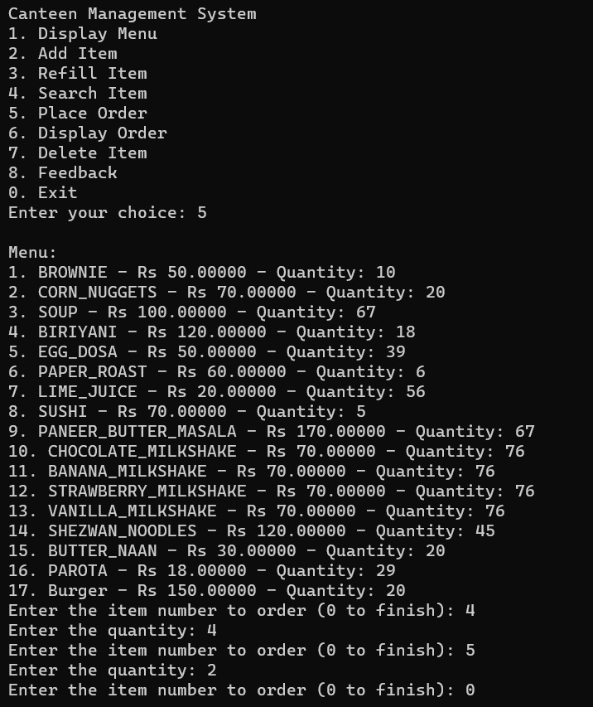
Output: Place order

Slide 34
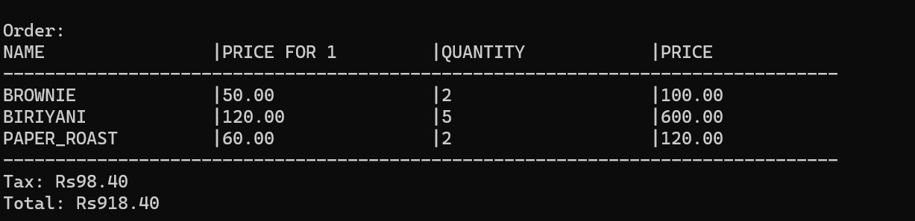
Output: Displaying placed order

Slide 35
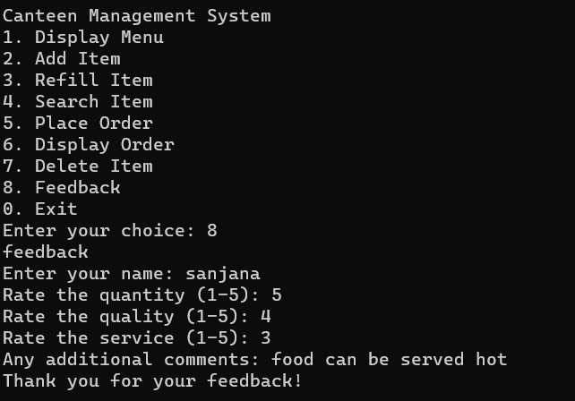
Output: Feedback of the food

Slide 36
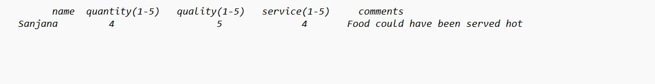
Output: Feedback of the food

Slide 37
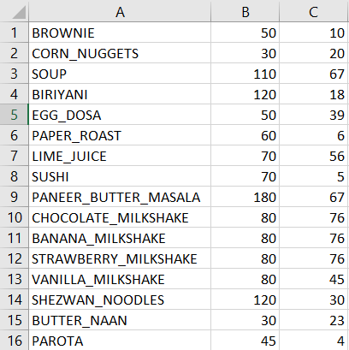
Menu in CSV file

Slide 38
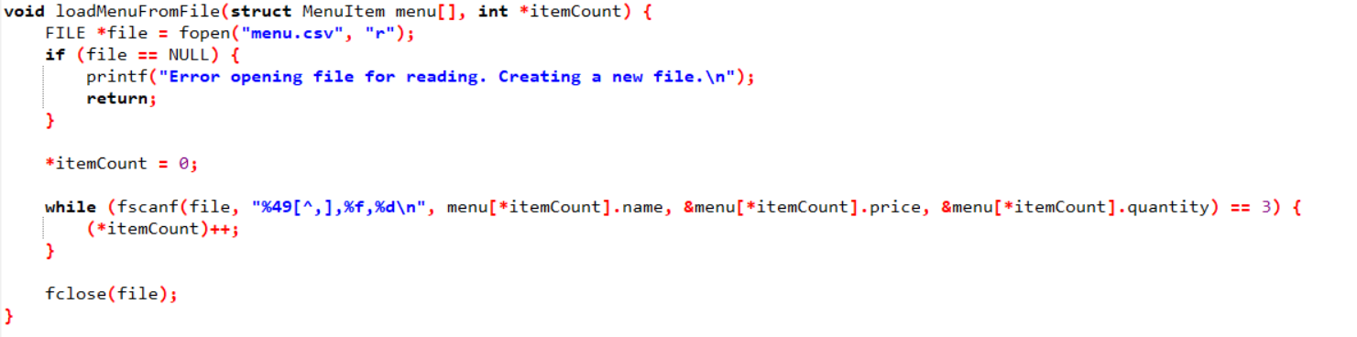
Function to load menu from csv file

Slide 39
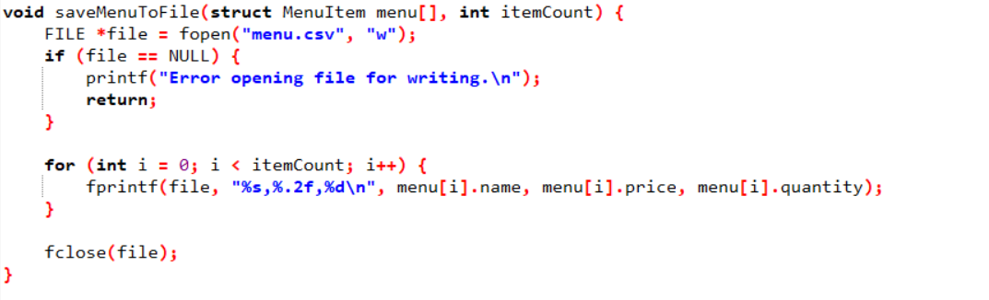
Function to save menu to csv file

Slide 40
Function to delete item

Slide 41
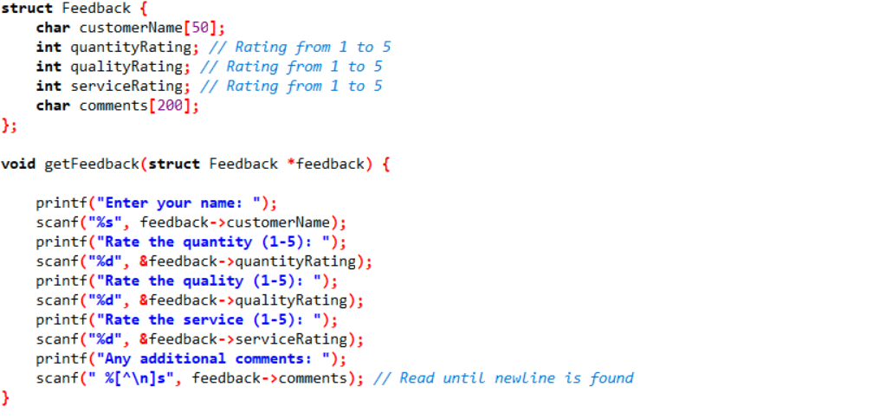
Function for feedback csv file

Slide 42
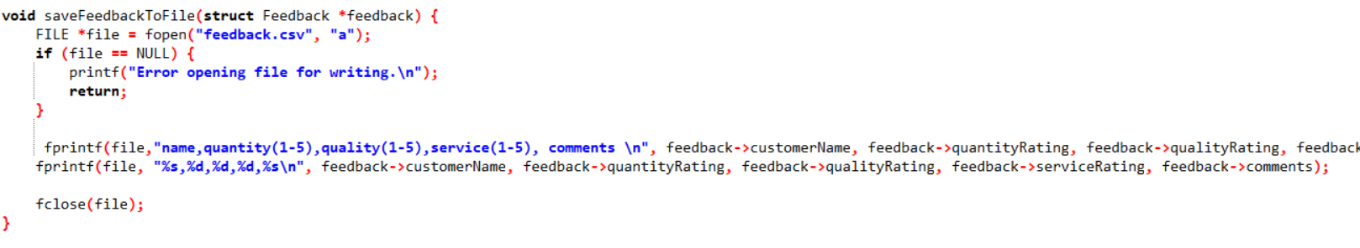
Function for feedback csv file

Slide 43
MAIN FUNCTION for Code with csv file

Slide 46
Output: Display menu

Slide 47
Output: Add item to menu

Slide 48
Output: Refill item to menu

Slide 49
Output: Search item in menu

Slide 50
Output: Place order

Slide 51
Output: Displaying placed order

Slide 52
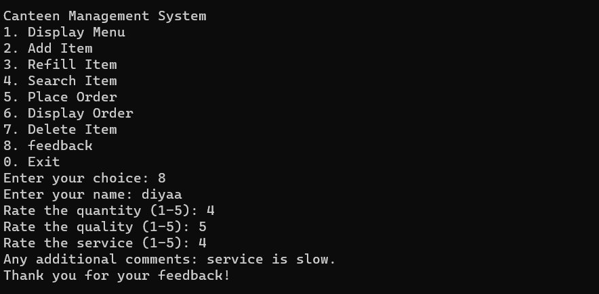
Output: Feedback of the food

Slide 53
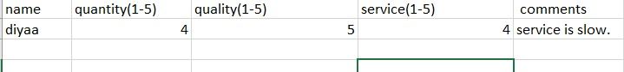
Output: Feedback of the food

Slide 54
Contributions
Shreya Arun: Implementing function for displaying menu, adding item, searching item, main function of txt and csv file and feedback.
Siri Sanjana : Implementing function for placing order, display the placed order and txt file.
Varshitha Thilak Kumar: Implementing function for refill of an item, delete item main function using switch cases and csv file

Slide 55
Bibliography
https://www.ijert.org/research/canteen-management-system-IJERTV12IS040301.pdfhttps:/
www.scribd.com/document/469658753/Canteen-management-system-FINAL-PROJECT
www.starlinkindia.com/blog/canteen-management-system-main-features-and-benefits/
https://labhak.com/canteen-management-systems-main-features-and-benefits/
https://www.linkedin.com/pulse/what-main-features-good-canteen-management-/
https://github.com/topics/canteen-mangement-system

